Slide 1
Big Data Open Source Software and Projects
Big Data Applications and Generalizing their Structure
I590 Data Science Curriculum
August 16 2014
Geoffrey Fox
gcf@indiana.edu
http://www.infomall.org
School of Informatics and Computing
Digital Science Center
Indiana University Bloomington

Slide 2
NIST Big Data Use Cases

Slide 3
51 Detailed Use Cases: Contributed July-September 2013
Covers goals, data features such as 3 V’s, software, hardware
http://bigdatawg.nist.gov/usecases.php
https://bigdatacoursespring2014.appspot.com/course (Section 5)
Government Operation(4): National Archives and Records Administration, Census Bureau
Commercial(8): Finance in Cloud, Cloud Backup, Mendeley (Citations), Netflix, Web Search, Digital Materials, Cargo shipping (as in UPS)
Defense(3): Sensors, Image surveillance, Situation Assessment
Healthcare and Life Sciences(10): Medical records, Graph and Probabilistic analysis, Pathology, Bioimaging, Genomics, Epidemiology, People Activity models, Biodiversity
Deep Learning and Social Media(6): Driving Car, Geolocate images/cameras, Twitter, Crowd Sourcing, Network Science, NIST benchmark datasets
The Ecosystem for Research(4): Metadata, Collaboration, Language Translation, Light source experiments
Astronomy and Physics(5): Sky Surveys including comparison to simulation, Large Hadron Collider at CERN, Belle Accelerator II in Japan
Earth, Environmental and Polar Science(10): Radar Scattering in Atmosphere, Earthquake, Ocean, Earth Observation, Ice sheet Radar scattering, Earth radar mapping, Climate simulation datasets, Atmospheric turbulence identification, Subsurface Biogeochemistry (microbes to watersheds), AmeriFlux and FLUXNET gas sensors
Energy(1): Smart grid
26 Features for each use case Biased to science

Slide 4
Examples: Especially Image based Applications I

Slide 5
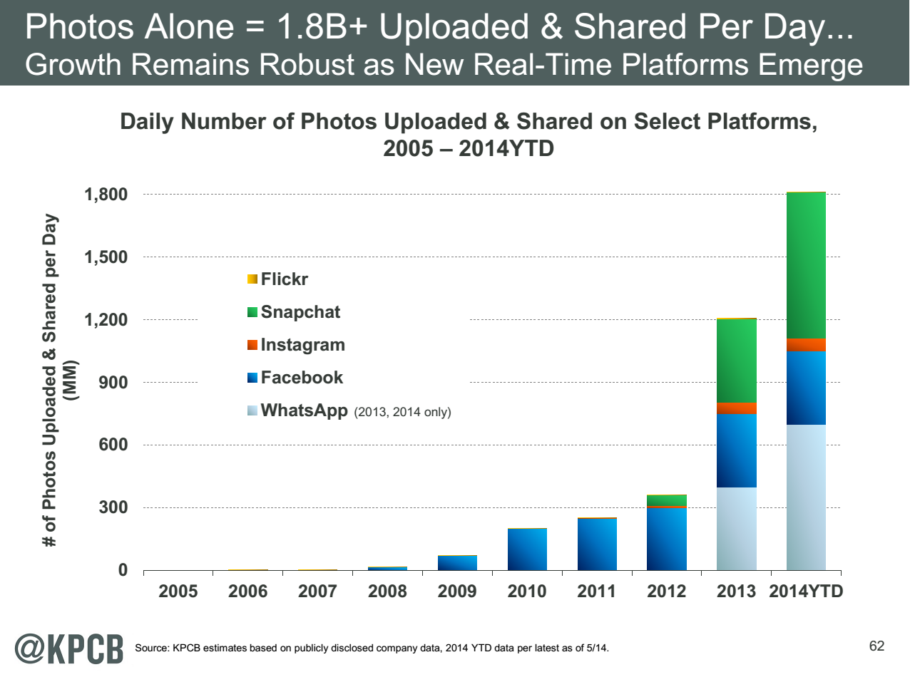
http://www.kpcb.com/internet-trends

Slide 6
13 Image-based Use Cases
13-15 Military Sensor Data Analysis/ Intelligence
PP, LML, GIS, MR
7:Pathology Imaging/ Digital Pathology: PP, LML,
MR for search becoming terabyte 3D images, Global Classification
18&35: Computational Bioimaging (Light Sources): PP, LML Also materials
26: Large-scale Deep Learning: GML Stanford ran 10 million images and 11 billion parameters on a 64 GPU HPC; vision (drive car), speech, and Natural Language Processing
27: Organizing large-scale, unstructured collections of photos: GML Fit position and camera direction to assemble 3D photo ensemble
36: Catalina Real-Time Transient Synoptic Sky Survey (CRTS): PP, LML followed by classification of events (GML)
43: Radar Data Analysis for CReSIS Remote Sensing of Ice Sheets: PP, LML to identify glacier beds; GML for full ice-sheet
44: UAVSAR Data Processing, Data Product Delivery, and Data Services: PP to find slippage from radar images
45, 46: Analysis of Simulation visualizations: PP LML ?GML find paths, classify orbits, classify patterns that signal earthquakes, instabilities, climate, turbulence

Slide 7
13: Cloud Large Scale Geospatial Analysis and Visualization
Application: Need to support large scale geospatial data analysis
and visualization with number of geospatially aware sensors and
the number of geospatially tagged data sources rapidly increasing.
Current Approach: Traditional GIS systems are generally capable of analyzing millions of objects and easily visualizing thousands. Data types include Imagery (various formats such as NITF, GeoTiff, CADRG), and vector with various formats like shape files, KML, text streams. Object types include points, lines, areas, polylines, circles, ellipses. Data accuracy very important with image registration and sensor accuracy relevant. Analytics include closest point of approach, deviation from route, and point density over time, PCA and ICA. Software includes Server with Geospatially enabled RDBMS, Geospatial server/analysis software – ESRI ArcServer, Geoserver; Visualization by ArcMap or browser based visualization
Futures: Today’s intelligence systems often contain trillions of geospatial objects and need to be able to visualize and interact with millions of objects. Critical issues are Indexing, retrieval and distributed analysis; Visualization generation and transmission; Visualization of data at the end of low bandwidth wireless connections; Data is sensitive and must be completely secure in transit and at rest (particularly on handhelds); Geospatial data requires unique approaches to indexing and distributed analysis.
Defense
PP, GIS, Classification
Streaming
Parallelism over Sensors and people accessing data

Slide 8
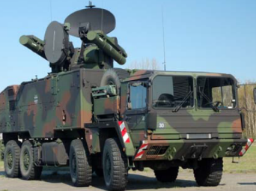
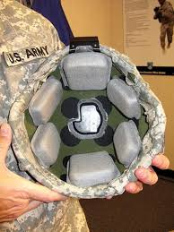
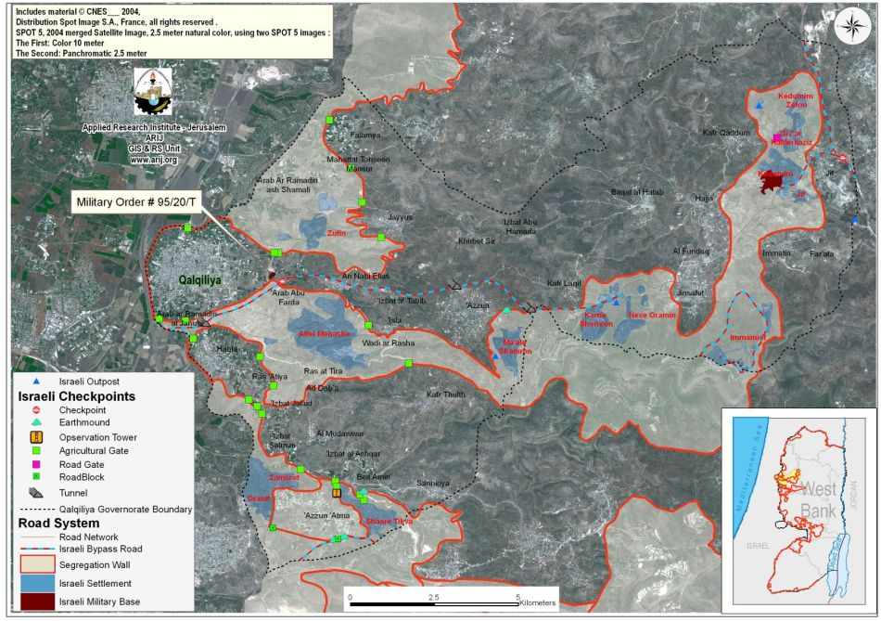
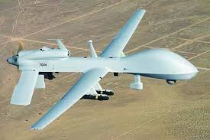
13: Cloud Large Scale Geospatial Analysis and Visualization
Defense
This introduces important concept of a Geographical Information System displaying results from sensors
GIS: Geotagged data and often displayed in ESRI, Google Earth etc.
PP, GIS, Classification
Streaming
Parallelism over Sensors and people accessing data

Slide 9
14: Object identification and tracking from Wide Area Large Format Imagery (WALF) Imagery or Full Motion Video (FMV) – Persistent Surveillance
Defense
Application: Persistent surveillance sensors can easily collect petabytes
of imagery data in the space of a few hours. The data should be reduced
to a set of geospatial object (points, tracks, etc.) which can easily be integrated with other data to form a common operational picture. Typical processing involves extracting and tracking entities (vehicles, people, packages) over time from the raw image data.
Current Approach: The data needs to be processed close to the sensor which is likely forward deployed since data is too large to be easily transmitted. Typical object extraction systems are currently small (1-20 node) GPU enhanced clusters. There are a wide range of custom software and tools including traditional RDBMS’s and display tools. Real time data obtained at FMV (Full Motion Video) – 30-60 frames per/sec at full color 1080P resolution or WALF (Wide Area Large Format) with 1-10 frames per/sec at 10Kx10K full color resolution. Visualization of extracted outputs will typically be as overlays on a geospatial (GIS) display. Analytics are basic object detection analytics and integration with sophisticated situation awareness tools with data fusion. Significant security issues to ensure the enemy is not able to know what we see.
Futures: Typical problem is integration of this processing into a large (GPU) cluster capable of processing data from several sensors in parallel and in near real time. Transmission of data from sensor to system is also a major challenge.
Streaming
PP, GIS, MR, MRIter? Classification
Parallelism over Sensors and people accessing data

Slide 10
15: Intelligence Data Processing and Analysis
Defense
Application: Allow Intelligence Analysts to a) Identify relationships
between entities (people, organizations, places, equipment) b) Spot trends in sentiment or intent for either general population or leadership group (state, non-state actors) c) Find location of and possibly timing of hostile actions (including implantation of IEDs) d) Track the location and actions of (potentially) hostile actors e) Ability to reason against and derive knowledge from diverse, disconnected, and frequently unstructured (e.g. text) data sources f) Ability to process data close to the point of collection and allow data to be shared easily to/from individual soldiers, forward deployed units, and senior leadership in garrison.
Current Approach: Software includes Hadoop, Accumulo (Big Table), Solr, Natural Language Processing, Puppet (for deployment and security) and Storm running on medium size clusters. Data size in 10s of Terabytes to 100s of Petabytes with Imagery intelligence device gathering petabyte in a few hours. Dismounted warfighters would have at most 1-100s of Gigabytes (typically handheld data storage).
Futures: Data currently exists in disparate silos which must be accessible through a semantically integrated data space. Wide variety of data types, sources, structures, and quality which will span domains and requires integrated search and reasoning. Most critical data is either unstructured or imagery/video which requires significant processing to extract entities and information. Network quality, Provenance and security essential.
Streaming
GIS, MR, MRIter?, Classification, Fusion
Parallelism over Sensors and people accessing data

Slide 11
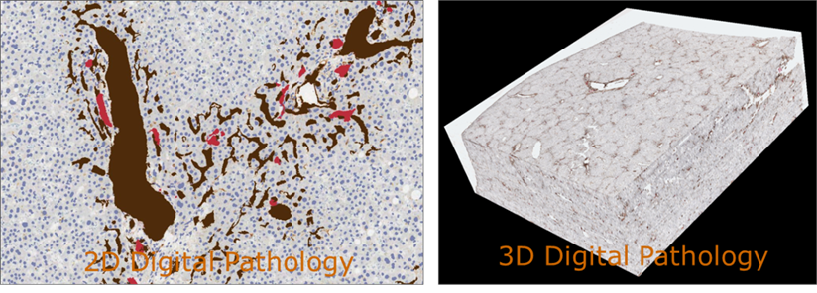
17:Pathology Imaging/
Digital Pathology I
Healthcare
Life Sciences
Application: Digital pathology imaging is an emerging field
where examination of high resolution images of tissue
specimens enables novel and more effective ways for disease diagnosis. Pathology image analysis segments massive (millions per image) spatial objects such as nuclei and blood vessels, represented with their boundaries, along with many extracted image features from these objects. The derived information is used for many complex queries and analytics to support biomedical research and clinical diagnosis.
MR, MRIter, PP, Classification
Streaming
Parallelism over Images

Slide 12
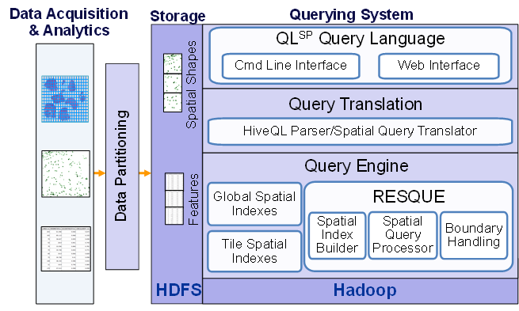
17:Pathology Imaging/ Digital Pathology II
Healthcare
Life Sciences
Current Approach: 1GB raw image data + 1.5GB analytical
results per 2D image. MPI for image analysis; MapReduce +
Hive with spatial extension on supercomputers and clouds. GPU’s used effectively. Figure below shows the architecture of Hadoop-GIS, a spatial data warehousing system over MapReduce to support spatial analytics for analytical pathology imaging.
Futures: Recently, 3D pathology imaging is made possible through 3D laser technologies or serially sectioning hundreds of tissue sections onto slides and scanning them into digital images. Segmenting 3D microanatomic objects from registered serial images could produce tens of millions of 3D objects from a single image. This provides a deep “map” of human tissues for next generation diagnosis. 1TB raw image data + 1TB analytical results per 3D image and 1PB data per moderated hospital per year.
Architecture of Hadoop-GIS, a spatial data warehousing system over MapReduce to support spatial analytics for analytical pathology imaging

Slide 13
26: Large-scale Deep Learning
Application: Large models (e.g., neural networks with more neurons
and connections) combined with large datasets are increasingly the
top performers in benchmark tasks for vision, speech, and Natural
Language Processing. One needs to train a deep neural network from a large (>>1TB) corpus of data (typically imagery, video, audio, or text). Such training procedures often require customization of the neural network architecture, learning criteria, and dataset pre-processing. In addition to the computational expense demanded by the learning algorithms, the need for rapid prototyping and ease of development is extremely high.
Current Approach: The largest applications so far are to image recognition and scientific studies of unsupervised learning with 10 million images and up to 11 billion parameters on a 64 GPU HPC Infiniband cluster. Both supervised (using existing classified images) and unsupervised applications
Futures: Large datasets of 100TB or more may be necessary in order to exploit the representational power of the larger models. Training a self-driving car could take 100 million images at megapixel resolution. Deep Learning shares many characteristics with the broader field of machine learning. The paramount requirements are high computational throughput for mostly dense linear algebra operations, and extremely high productivity for researcher exploration. One needs integration of high performance libraries with high level (python) prototyping environments
Classified OUT
IN
Deep Learning, Social Networking
GML, EGO, MRIter, Classify

Slide 14
27: Organizing large-scale, unstructured collections of consumer photos I
Application: Produce 3D reconstructions of
scenes using collections of millions to billions
of consumer images, where neither the scene structure nor the camera positions are known a priori. Use resulting 3d models to allow efficient browsing of large-scale photo collections by geographic position. Geolocate new images by matching to 3d models. Perform object recognition on each image. 3d reconstruction posed as a robust non-linear least squares optimization problem where observed relations between images are constraints and unknowns are 6-d camera pose of each image and 3-d position of each point in the scene.
Current Approach: Hadoop cluster with 480 cores processing data of initial applications. Note over 500 billion images on Facebook and over 5 billion on Flickr with over 500 million images added to social media sites each day.
EGO, GIS, MR, Classification
Parallelism over Photos
Deep Learning
Social Networking

Slide 15
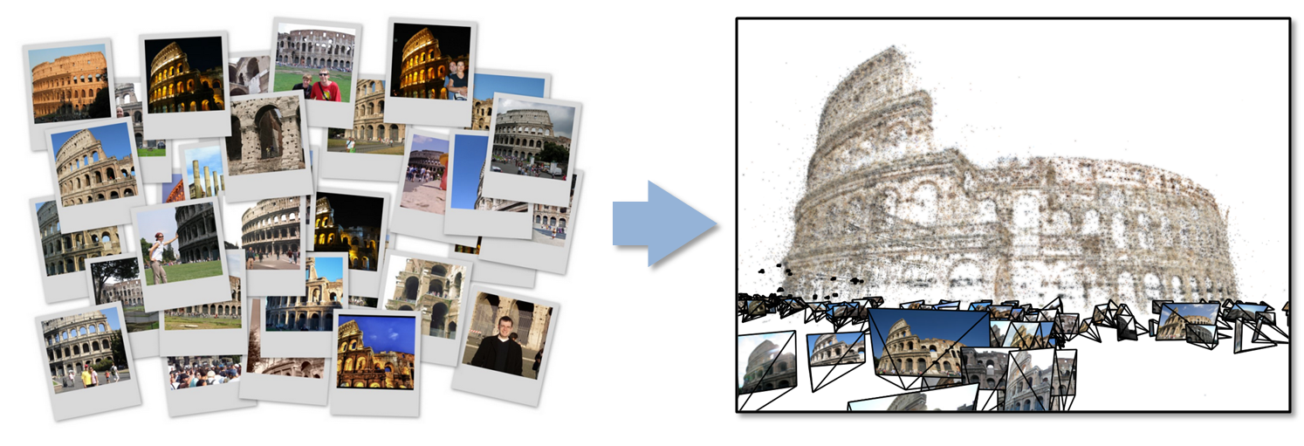
27: Organizing large-scale, unstructured collections of consumer photos II
Deep Learning
Social Networking
Futures: Need many analytics including feature extraction, feature matching, and large-scale probabilistic inference, which appear in many or most computer vision and image processing problems, including recognition, stereo resolution, and image denoising. Need to visualize large-scale 3-d reconstructions, and navigate large-scale collections of images that have been aligned to maps.

Slide 16
Examples: Especially Image based Applications II

Slide 17
36: Catalina Real-Time Transient Survey (CRTS): a digital, panoramic, synoptic sky survey I
Astronomy & Physics
Application: The survey explores the variable universe in the visible
light regime, on time scales ranging from minutes to years, by searching for variable and transient sources. It discovers a broad variety of astrophysical objects and phenomena, including various types of cosmic explosions (e.g., Supernovae), variable stars, phenomena associated with accretion to massive black holes (active galactic nuclei) and their relativistic jets, high proper motion stars, etc. The data are collected from 3 telescopes (2 in Arizona and 1 in Australia), with additional ones expected in the near future (in Chile).
Current Approach: The survey generates up to ~ 0.1 TB on a clear night with a total of ~100 TB in current data holdings. The data are preprocessed at the telescope, and transferred to Univ. of Arizona and Caltech, for further analysis, distribution, and archiving. The data are processed in real time, and detected transient events are published electronically through a variety of dissemination mechanisms, with no proprietary withholding period (CRTS has a completely open data policy). Further data analysis includes classification of the detected transient events, additional observations using other telescopes, scientific interpretation, and publishing. In this process, it makes a heavy use of the archival data (several PB’s) from a wide variety of geographically distributed resources connected through the Virtual Observatory (VO) framework.
PP, ML, Classification
Streaming
Parallelism over Images and Events: Celestial events identified in Telescope Images

Slide 18
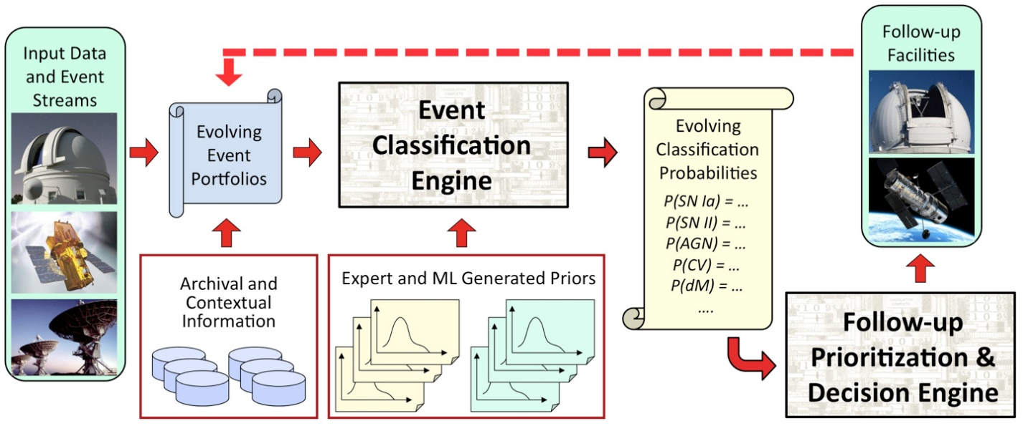
36: Catalina Real-Time Transient Survey (CRTS): a digital, panoramic, synoptic sky survey II
Astronomy & Physics
Futures: CRTS is a scientific and methodological testbed
and precursor of larger surveys to come, notably the
Large Synoptic Survey Telescope (LSST), expected to operate in 2020’s and selected as the highest-priority ground-based instrument in the 2010 Astronomy and Astrophysics Decadal Survey. LSST will gather about 30 TB per night.

Slide 19
35: Light source beamlines
Application: Samples are exposed to X-rays from light sources
in a variety of configurations depending on the experiment.
Detectors (essentially high-speed digital cameras) collect the data. The data are then analyzed to reconstruct a view of the sample or process being studied.
Current Approach: A variety of commercial and open source software is used for data analysis – examples including Octopus for Tomographic Reconstruction, Avizo (http://vsg3d.com) and FIJI (a distribution of ImageJ) for Visualization and Analysis. Data transfer is accomplished using physical transport of portable media (severely limits performance) or using high-performance GridFTP, managed by Globus Online or workflow systems such as SPADE.
Futures: Camera resolution is continually increasing. Data transfer to large-scale computing facilities is becoming necessary because of the computational power required to conduct the analysis on time scales useful to the experiment. Large number of beamlines (e.g. 39 at LBNL ALS) means that total data load is likely to increase significantly and require a generalized infrastructure for analyzing gigabytes per second of data from many beamline detectors at multiple facilities.
Research Ecosystem PP, LML, Streaming

Slide 20
43: Radar Data Analysis for CReSIS Remote Sensing of Ice Sheets I
Application: This data feeds into intergovernmental Panel
on Climate Change (IPCC) and uses custom radars to
measures ice sheet bed depths and (annual) snow layers
at the North and South poles and mountainous regions.
Current Approach: The initial analysis is currently Matlab signal processing that produces a set of radar images. These cannot be transported from field over Internet and are typically copied to removable few TB disks in the field and flown “home” for detailed analysis. Image understanding tools with some human oversight find the image features (layers) shown later, that are stored in a database front-ended by a Geographical Information System. The ice sheet bed depths are used in simulations of glacier flow. The data is taken in “field trips” that each currently gather 50-100 TB of data over a few week period.
Futures: An order of magnitude more data (petabyte per mission) is projected with improved instrumentation. Demands of processing increasing field data in an environment with more data but still constrained power budget, suggests low power/performance architectures such as GPU systems.
Earth, Environmental and Polar Science
PP, GIS
Streaming
Parallelism over Radar Images

Slide 21
43: Radar Data Analysis for CReSIS Remote Sensing of Ice Sheets II
Typical CReSIS data showing aircraft taking data which shows a glacier bed at a depth of 3100 meters with multiple confusing reflections.
Earth, Environmental and Polar Science

Slide 22
43: Radar Data Analysis for CReSIS Remote Sensing of Ice Sheets III
Earth, Environmental and Polar Science
Typical flight paths of CReSIS data gathering in survey region

Slide 23
43: Radar Data Analysis for CReSIS Remote Sensing of Ice Sheets IV
Earth, Environmental and Polar Science
Typical CReSIS echogram with Detected Boundaries. The
upper (green) boundary is between air and ice layer
while the lower (red) boundary is between ice and terrain
PP, GIS
Streaming
Parallelism over Radar Images

Slide 24
44: UAVSAR Data Processing, Data Product Delivery, and Data Services I
Application: Synthetic Aperture Radar (SAR) can
identify landscape changes caused by seismic
activity, landslides, deforestation, vegetation
changes and flooding. This is for example used to support earthquake science (see next slide) as well as disaster management. This use case supports the storage, application of image processing and visualization of this geo-located data with angular specification.
Current Approach: Data from planes and satellites is processed on NASA computers before being stored after substantial data communication. The data is made public as soon as processed and requires significant curation due to instrumental glitches. The current data size is ~150TB
Futures: The data size would increase dramatically if Earth Radar Mission launched. Clouds are suitable hosts but are not used today in production.
Earth, Environmental and Polar Science
PP, GIS
Streaming
Parallelism over Radar Images

Slide 25
44: UAVSAR Data Processing, Data Product Delivery, and Data Services II
Earth, Environmental and Polar Science
Combined unwrapped coseismic interferograms for flight lines 26501, 26505, and 08508 for the October 2009 – April 2010 time period. End points where slip can be seen on the Imperial, Superstition Hills, and Elmore Ranch faults are noted. GPS stations are marked by dots and are labeled.
PP, GIS
Streaming
Parallelism over Radar Images

Slide 26
Examples: Especially Internet of Things based Applications

Slide 27
Internet of Things and Streaming Apps
It is projected that there will be 24 (Mobile Industry
Group) to 50 (Cisco) billion devices
on the Internet by 2020.
The cloud natural controller of and resource provider
for the Internet of Things.
Smart phones/watches, Wearable devices (Smart People), “Intelligent River” “Smart Homes and Grid” and “Ubiquitous Cities”, Robotics.
Majority of use cases are streaming – experimental science gathers data in a stream – sometimes batched as in a field trip. Below is sample
10: Cargo Shipping Tracking as in UPS, Fedex PP GIS LML
13: Large Scale Geospatial Analysis and Visualization PP GIS LML (in image set)
28: Truthy: Information diffusion research from Twitter Data PP MR for Search, GML for community determination
39: Particle Physics: Analysis of LHC Large Hadron Collider Data: Discovery of Higgs particle PP Local Processing Global statistics
50: DOE-BER AmeriFlux and FLUXNET Networks PP GIS LML
51: Consumption forecasting in Smart Grids PP GIS LML

Slide 28
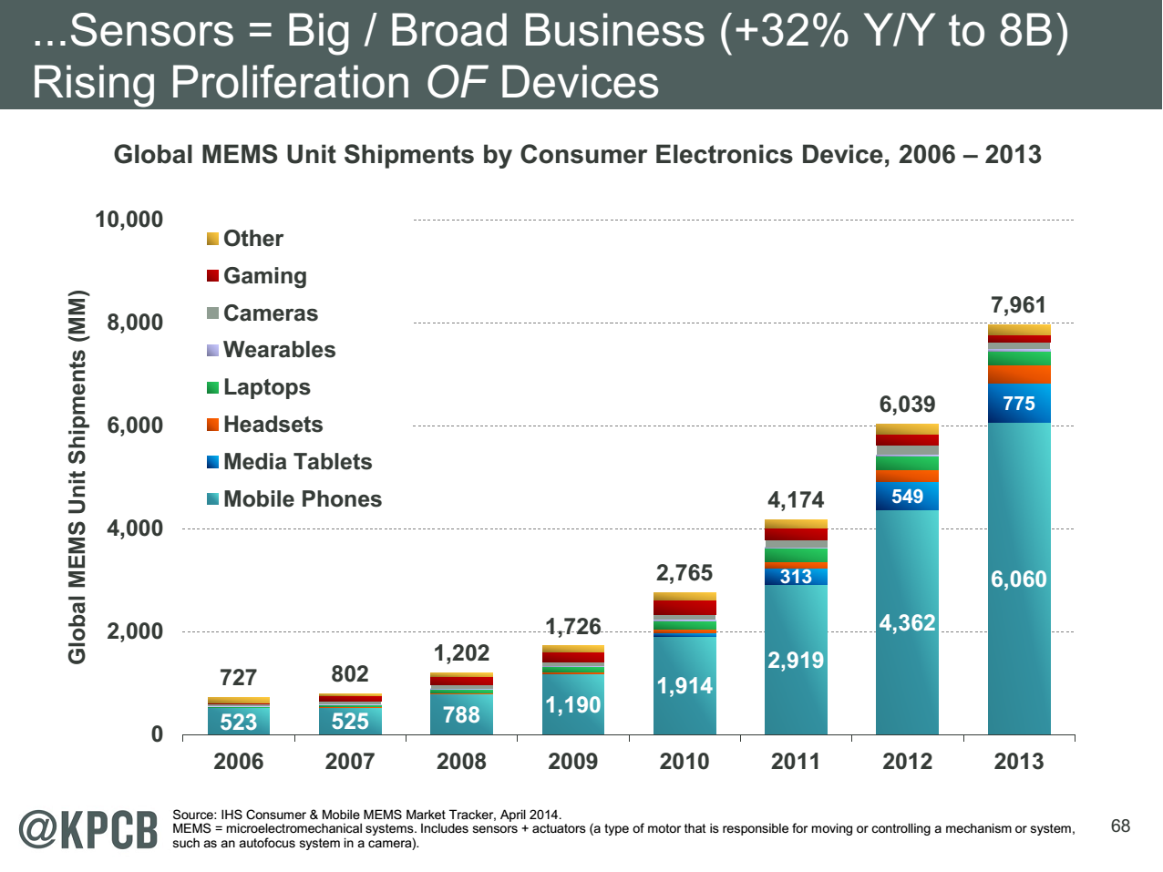
http://www.kpcb.com/internet-trends

Slide 29
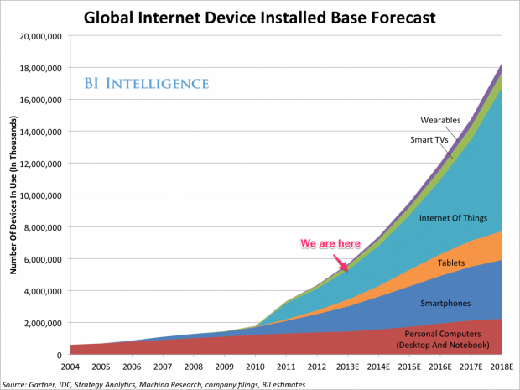

Slide 30
http://www.kpcb.com/internet-trends

Slide 31

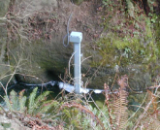
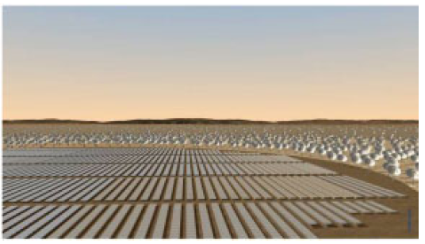
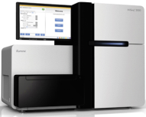
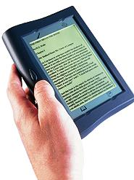




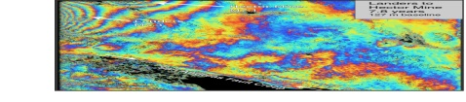
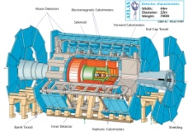
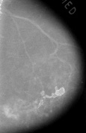

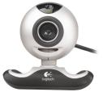

Raw Data → Data → Information → Knowledge → Wisdom → Decisions
Another
Grid
SS
SS
SS
SS
SS
SS
SS
Filter
Cloud
Discovery
Cloud
Portal
Filter
Cloud
Fusion for Discovery/Decisions
SS
Filter
Cloud
Another
Service
SS
Filter
Cloud
Filter
Cloud
Filter
Cloud
Discovery
Cloud
SS
SS
SS: Sensor or Data
Interchange
Service
Workflow through multiple filter/discovery clouds
Filter
Cloud
Filter
Cloud
Filter
Cloud
Filter
Cloud
SS
Another
Cloud
SS
SS
SS
SS
SS
SS
SS
SS
SS
SS
SS
SS
SS
Compute
Cloud
Storage
Cloud
Distributed
Grid
Hadoop Cluster
Database

Slide 32
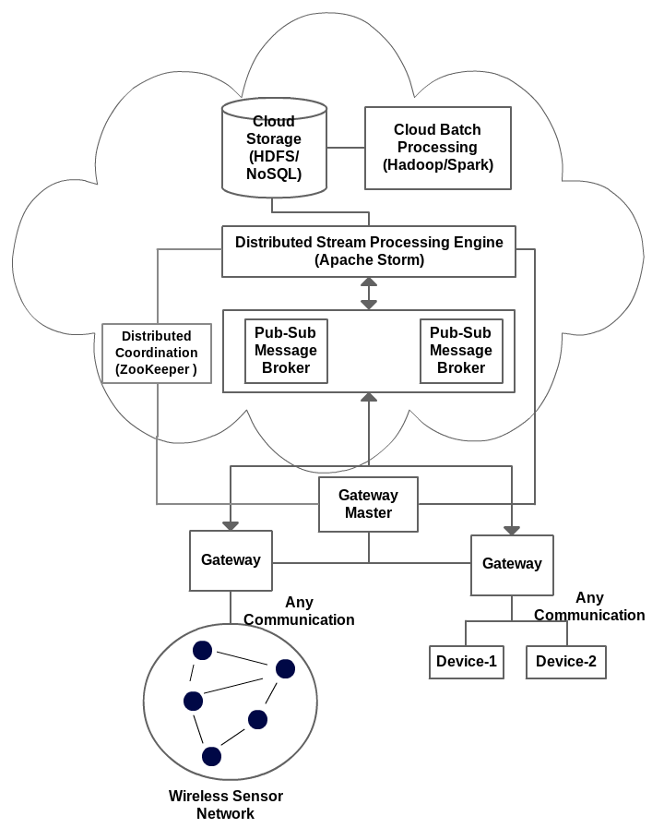
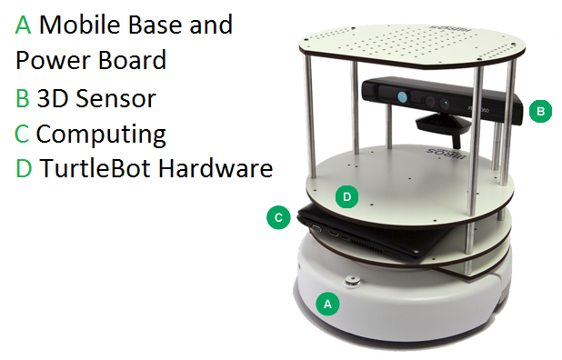
IOTCloud
Device → Pub-Sub→Storm → Datastore → Data Analysis
Apache Storm provides scalable distributed system for processing data streams coming from devices in real time.
For example Storm layer can decide to store the data in cloud storage for further analysis or to send control data back to the devices
Evaluating Pub-Sub Systems ActiveMQ, RabbitMQ, Kafka, Kestrel
Turtlebot and Kinect

Slide 33
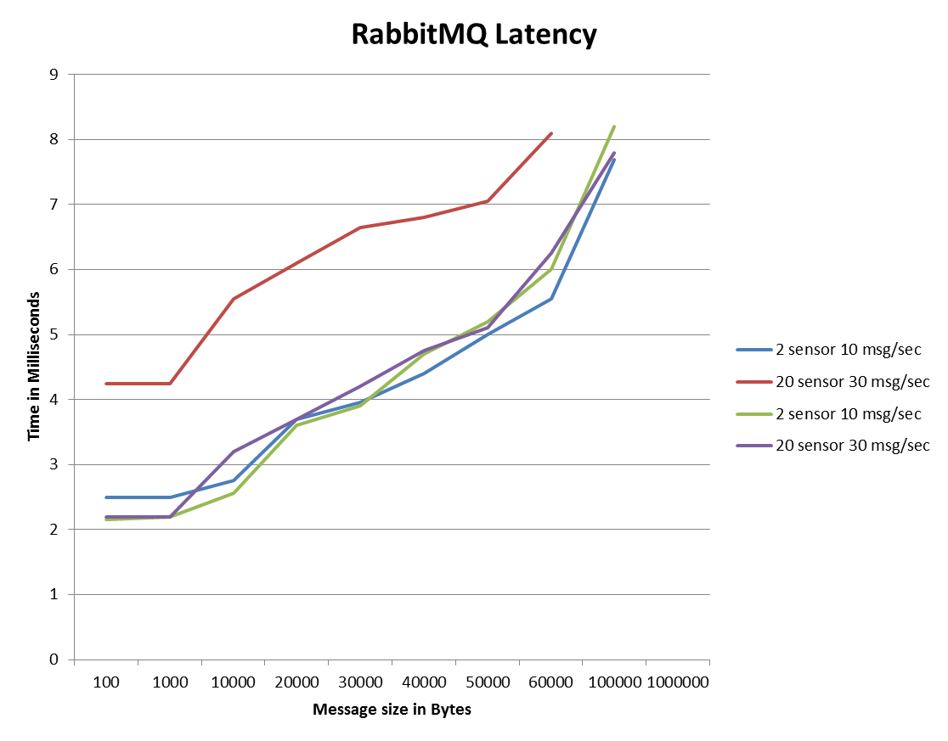
Storm Performance
From Device to Cloud
6 FutureGrid India Medium OpenStack machines
1 Broker machine, RabbitMQ 1 machine hosting ZooKeeper and Storm – Nimbus (Master for Storm)
2 Sensor sites generating data
2 Storm nodes sending back the same data and we measure the unidirectional latency
Using drones and Kinects
System saturates

Slide 34
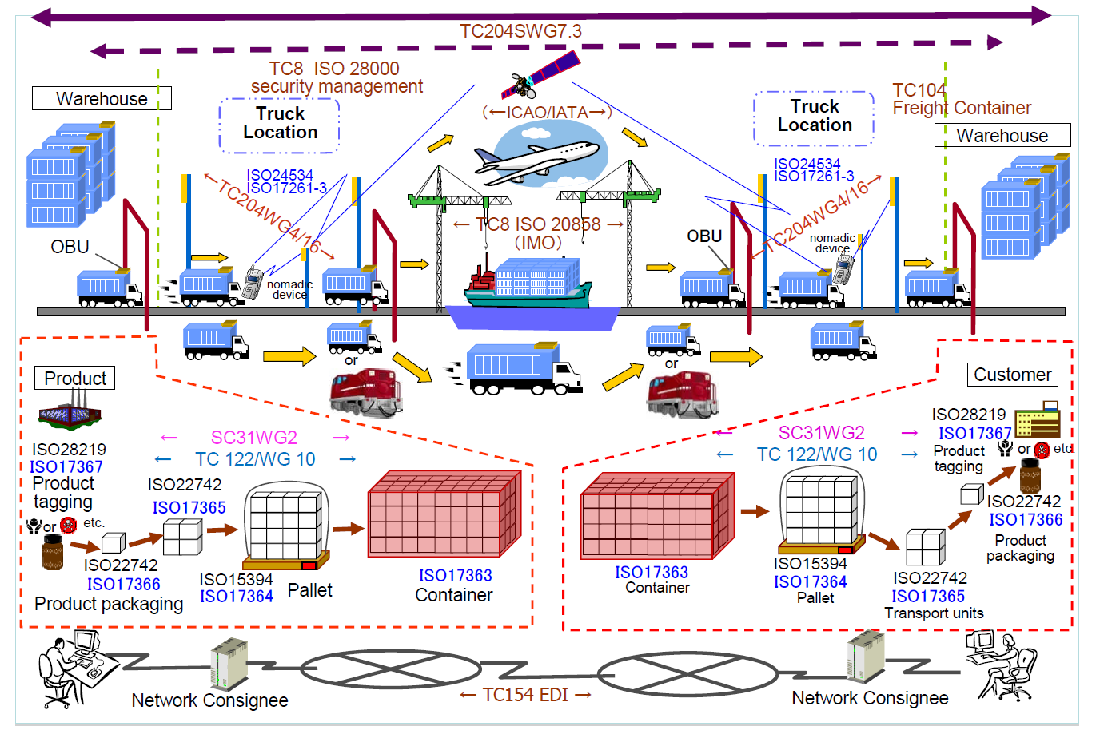
10: Cargo Shipping Architecture
Commercial
Industry Standards
Continuous Tracking
PP Streaming

Slide 35
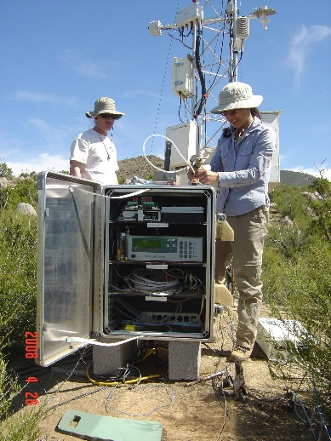
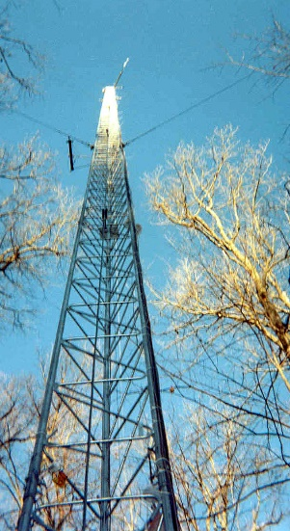
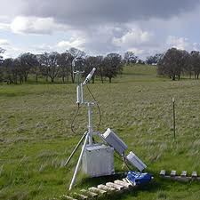
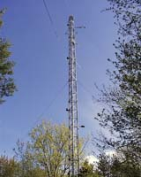
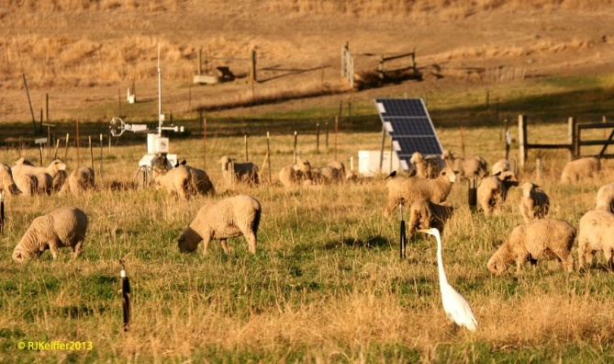
50: DOE-BER AmeriFlux and FLUXNET Networks
Earth, Environmental and Polar Science
Application: AmeriFlux and FLUXNET are US and world collections
respectively of sensors that observe trace gas fluxes (CO₂,
water vapor) across a broad spectrum of times (hours, days,
seasons, years, and decades) and space. Moreover, such datasets provide the crucial linkages among organisms, ecosystems, and process-scale studies—at climate-relevant scales of landscapes, regions, and continents—for incorporation into biogeochemical and climate models.
Current Approach: Software includes EddyPro, Custom analysis software, R, python, neural networks, Matlab. There are ~150 towers in AmeriFlux and over 500 towers distributed globally collecting flux measurements.
Futures: Field experiment data taking would be improved by access to existing data and automated entry of new data via mobile devices. Need to support interdisciplinary study integrating diverse data sources.
Fusion, PP, GIS
Streaming
Parallelism over Sensors

Slide 36
51: Consumption forecasting in Smart Grids
Energy
Application: Predict energy consumption for customers,
transformers, sub-stations and the electrical grid service
area using smart meters providing measurements every
15-mins at the granularity of individual consumers within the service area of smart power utilities. Combine Head-end of smart meters (distributed), Utility databases (Customer Information, Network topology; centralized), US Census data (distributed), NOAA weather data (distributed), Micro-grid building information system (centralized), Micro-grid sensor network (distributed). This generalizes to real-time data-driven analytics for time series from cyber physical systems
Current Approach: GIS based visualization. Data is around 4 TB a year for a city with 1.4M sensors in Los Angeles. Uses R/Matlab, Weka, Hadoop software. Significant privacy issues requiring anonymization by aggregation. Combine real time and historic data with machine learning for predicting consumption.
Futures: Wide spread deployment of Smart Grids with new analytics integrating diverse data and supporting curtailment requests. Mobile applications for client interactions.
Fusion, PP, MR, ML, GIS, Classification
Streaming
Parallelism over Sensors

Slide 37
28: Truthy: Information diffusion research using Twitter Data
Deep Learning
Social Networking
Application: Understanding how communication
spreads on socio-technical networks. Detecting
potentially harmful information spread at the early stage (e.g., deceiving messages, orchestrated campaigns, untrustworthy information, etc.)
Current Approach: 1) Acquisition and storage of a large volume (30 TB a year compressed) of continuous streaming data from Twitter (~100 million messages per day, ~500GB data/day increasing over time); (2) near real-time analysis of such data, for anomaly detection, stream clustering, signal classification and online-learning; (3) data retrieval, big data visualization, data-interactive Web interfaces, public API for data querying. Use Python/SciPy/NumPy/MPI for data analysis. Information diffusion, clustering, and dynamic network visualization capabilities already exist
Futures: Truthy plans to expand incorporating Google+ and Facebook. Need to move towards Hadoop/IndexedHBase & HDFS distributed storage. Previously used Redis as an in-memory database to be a buffer for real-time analysis. Need streaming clustering, anomaly detection and online learning.
Index, S/Q, MR, MRIter, Graph, Classification
Streaming
Parallelism over Tweets

Slide 38
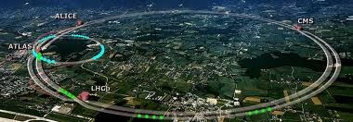
39: Particle Physics: Analysis of LHC Large Hadron Collider Data: Discovery of Higgs particle I
CERN LHC Accelerator Ring (27 km circumference. Up to 175m depth) at Geneva with 4 Experiment positions marked
Application: One analyses collisions at the CERN LHC (Large Hadron Collider) Accelerator and Monte Carlo producing events describing particle-apparatus interaction. Processed information defines physics properties of events (lists of particles with type and momenta). These events are analyzed to find new effects; both new particles (Higgs) and present evidence that conjectured particles (Supersymmetry) have not been detected. LHC has a few major experiments including ATLAS and CMS. These experiments have global participants (for example CMS has 3600 participants from 183 institutions in 38 countries), and so the data at all levels is transported and accessed across continents.
MRStat or PP, MC
Parallelism over observed collisions
Astronomy & Physics

Slide 39
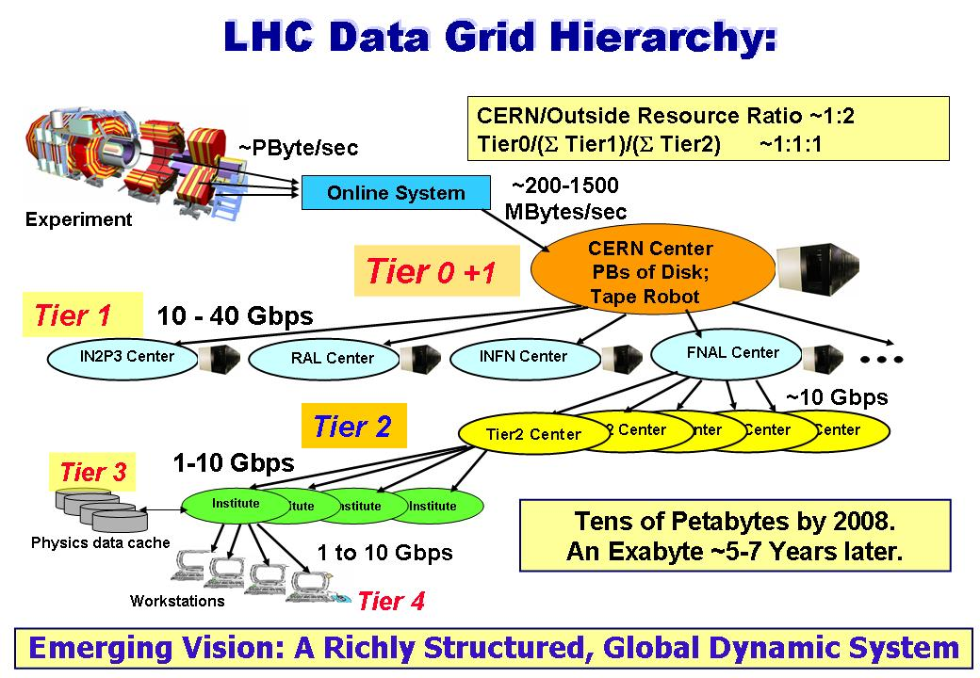
39: Particle Physics: Analysis of LHC Large Hadron Collider Data: Discovery of Higgs particle II
Current Approach: The LHC experiments are pioneers of a
distributed Big Data science infrastructure, and several aspects
of the LHC experiments’ workflow highlight issues that other disciplines will need to solve. These include automation of data distribution, high performance data transfer, and large-scale high-throughput computing. Grid analysis with 350,000 cores running “continuously” over 2 million jobs per day arranged in 3 tiers (CERN, “Continents/Countries”. “Universities”). Uses “Distributed High Throughput Computing” (Pleasing parallel) architecture with facilities integrated across the world by WLCG (LHC Computing Grid) and Open Science Grid in the US.
15 Petabytes data gathered each year from Accelerator data and Analysis with 200PB total. Specifically in 2012 ATLAS had at Brookhaven National Laboratory (BNL) 8PB Tier1 tape; BNL over 10PB Tier1 disk and US Tier2 centers 12PB disk cache. CMS has similar data sizes. Note over half resources used for Monte Carlo simulations as opposed to data analysis

Slide 40
Big Data Patterns – the Ogres

Slide 41
Distributed Computing Practice for Large-Scale Science & Engineering
S. Jha, M. Cole, D. Katz, O. Rana, M. Parashar, and J. Weissman,
Characteristics of 6 Distributed Applications – NOTE DATAFLOW
Application Example | Execution Unit | Communication | Coordination | Execution Environment
Montage | Multiple sequential and parallel executable | Files | Dataflow (DAG) | Dynamic process creation, execution
NEKTAR | Multiple concurrent parallel executables | Stream based | Dataflow | Co-scheduling, data streaming, async. I/O
Replica-Exchange | Multiple seq. and parallel executables | Pub/sub | Dataflow and events | Decoupled coordination and messaging
Climate Prediction (generation) | Multiple seq. & parallel executables | Files and messages | Master-Worker, events | @Home (BOINC)
Climate Prediction (analysis) | Multiple seq. & parallel executables | Files and messages | Dataflow | Dynamics process creation, workflow execution
SCOOP | Multiple Executable | Files and messages | Dataflow | Preemptive scheduling, reservations
Coupled Fusion | Multiple executable | Stream-based | Dataflow | Co-scheduling, data streaming, async I/O
Work of

Slide 42
10 Security & Privacy Use Cases
Consumer Digital Media Usage
Nielsen Homescan
Web Traffic Analytics
Health Information Exchange
Personal Genetic Privacy
Pharma Clinic Trial Data Sharing
Cyber-security
Aviation Industry
Military - Unmanned Vehicle sensor data
Education - “Common Core” Student Performance Reporting

Slide 43
7 Computational Giants of
NRC Massive Data Analysis Report
http://www.nap.edu/catalog.php?record_id=18374
G1: Basic Statistics e.g. MRStat
G2: Generalized N-Body Problems
G3: Graph-Theoretic Computations
G4: Linear Algebraic Computations
G5: Optimizations e.g. Linear Programming
G6: Integration e.g. LDA and other GML
G7: Alignment Problems e.g. BLAST

Slide 44
Would like to capture
“essence of these use cases”
“small” kernels, mini-apps
Or Classify applications into patterns
Do it from HPC background not database viewpoint
e.g. focus on cases with detailed analytics
Section 5 of my class https://bigdatacoursespring2014.appspot.com/preview classifies 51 use cases with ogre facets

Slide 45
HPC Benchmark Classics
Linpack or HPL: Parallel LU factorization
for solution of linear equations
NPB version 1: Mainly classic HPC solver kernels
  MG: Multigrid
  CG: Conjugate Gradient
  FT: Fast Fourier Transform
  IS: Integer sort
  EP: Embarrassingly Parallel
  BT: Block Tridiagonal
  SP: Scalar Pentadiagonal
  LU: Lower-Upper symmetric Gauss Seidel

Slide 46
13 Berkeley Dwarfs
Dense Linear Algebra
Sparse Linear Algebra
Spectral Methods
N-Body Methods
Structured Grids
Unstructured Grids
MapReduce
Combinational Logic
Graph Traversal
Dynamic Programming
Backtrack and
Branch-and-Bound
Graphical Models
Finite State Machines
First 6 of these correspond to Colella’s original.
Monte Carlo dropped.
N-body methods are a subset of Particle in Colella.
Note a little inconsistent in that MapReduce is a programming model and spectral method is a numerical method.
Need multiple facets!

Slide 47
Facets of the Ogres
Meta or Macro Aspects:
Problem Architecture and Computational Features

Slide 48
Problem Architecture Facet of Ogres (Meta or MacroPattern)
Pleasingly Parallel – as in BLAST, Protein docking, some
(bio-)imagery including Local Analytics or Machine Learning –
ML or filtering pleasingly parallel, as in bio-imagery, radar images
(pleasingly parallel but sophisticated local analytics)
Classic MapReduce: Search, Index and Query and Classification algorithms like collaborative filtering (G1 for MRStat in Features, G7)
Global Analytics or Machine Learning requiring iterative programming models (G5,G6). Often from
  Maximum Likelihood or χ² minimizations
  Expectation Maximization (often Steepest descent)
Problem set up as a graph (G3) as opposed to vector, grid
SPMD: Single Program Multiple Data
BSP or Bulk Synchronous Processing: well-defined compute-communication phases
Fusion: Knowledge discovery often involves fusion of multiple methods.
Workflow: All applications often involve orchestration (workflow) of multiple components
Use Agents: as in epidemiology (swarm approaches)
Note problem and machine architectures are related
Notes:
Big dwarfs are Ogres
Implement Ogres in ABDS+

Slide 49
One Facet of Ogres has
Computational Features
Flops per byte;
Communication Interconnect requirements;
Is application (graph) constant or dynamic?
Most applications consist of a set of interconnected entities; is this regular as a set of pixels or is it a complicated irregular graph?
Is communication BSP, Asynchronous, Pub-Sub, Collective, Point to Point?
Are algorithms Iterative or not?
Are algorithms governed by dataflow
Data Abstraction: key-value, pixel, graph, vector
  Are data points in metric or non-metric spaces?
  Is algorithm O(N²) or O(N) (up to logs) for N points per iteration (G2)
Core libraries needed: matrix-matrix/vector algebra, conjugate gradient, reduction, broadcast

Slide 50
Facets of the Ogres
Data Source and Style Aspects

Slide 51
Data Source and Style
Facet of Ogres I
(i) SQL or NoSQL: NoSQL includes Document,
Column, Key-value, Graph, Triple store
(ii) Other Enterprise data systems: 10 examples from NIST integrate SQL/NoSQL
(iii) Set of Files: as managed in iRODS and extremely common in scientific research
(iv) File, Object, Blob and Data-parallel (HDFS) raw storage: Separated from computing or colocated?
(v) Internet of Things: 24 to 50 Billion devices on Internet by 2020
(vi) Streaming: Incremental update of datasets with new algorithms to achieve real-time response (G7)
(vii) HPC simulations: generate major (visualization) output that often needs to be mined
(viii) Involve GIS: Geographical Information Systems provide attractive access to geospatial data
Notes:
Big dwarfs are Ogres
Implement Ogres in ABDS+

Slide 52
Data Source and Style
Facet of Ogres II
Before data gets to compute system, there is often an initial data gathering phase which is characterized by a block size and timing. Block size varies from month (Remote Sensing, Seismic) to day (genomic) to seconds or lower (Real time control, streaming)
There are storage/compute system styles: Shared, Dedicated, Permanent, Transient
Other characteristics are needed for permanent auxiliary/comparison datasets and these could be interdisciplinary, implying nontrivial data movement/replication
Notes:
Big dwarfs are Ogres
Implement Ogres in ABDS+

Slide 53
Analytics Facet (kernels) of the Ogres

Slide 54
Core Analytics Ogres
(microPattern) I
Map-Only
  Pleasingly parallel - Local Machine Learning
MapReduce: Search/Query/Index
  Summarizing statistics as in LHC Data analysis (histograms) (G1)
  Recommender Systems (Collaborative Filtering)
  Linear Classifiers (Bayes, Random Forests)
Alignment and Streaming (G7)
  Genomic Alignment, Incremental Classifiers
Global Analytics
Nonlinear Solvers (structure depends on objective function) (G5,G6)
  Stochastic Gradient Descent SGD
  (L-)BFGS approximation to Newton’s Method
  Levenberg-Marquardt solver

Slide 55
Core Analytics Ogres
(microPattern) II
Map-Collective (See Mahout, MLlib)
(G2,G4,G6)
  Often use matrix-matrix,-vector operations, solvers (conjugate gradient)
  Outlier Detection, Clustering (many methods),
  Mixture Models, LDA (Latent Dirichlet Allocation), PLSI (Probabilistic Latent Semantic Indexing)
  SVM and Logistic Regression
  PageRank, (find leading eigenvector of sparse matrix)
  SVD (Singular Value Decomposition)
  MDS (Multidimensional Scaling)
  Learning Neural Networks (Deep Learning)
  Hidden Markov Models

Slide 56
Core Analytics Ogres
(microPattern) III
Global Analytics – Map-Communication (targets for Giraph) (G3)
  Graph Structure (Communities, subgraphs/motifs, diameter, maximal cliques, connected components)
  Network Dynamics - Graph simulation Algorithms (epidemiology)
Global Analytics – Asynchronous Shared Memory (may be distributed algorithms)
  Graph Structure (Betweenness centrality, shortest path) (G3)
  Linear/Quadratic Programming, Combinatorial Optimization, Branch and Bound (G5)

Slide 57
Lessons / Insights
Proposed classification of Big Data applications with features and kernels for analytics
  Add other Ogres for workflow, data systems etc.
Looked at Image-based and Streaming Big Data Problems
Data intensive algorithms do not have the well developed high performance libraries familiar from HPC
Challenges with O(N²) problems
Global Machine Learning or (Exascale Global Optimization) particularly challenging

